Slide 1



Azure Cosmos DB
More than a database
Alex Drenea
Cloud Solution Architect
Microsoft

Slide 2
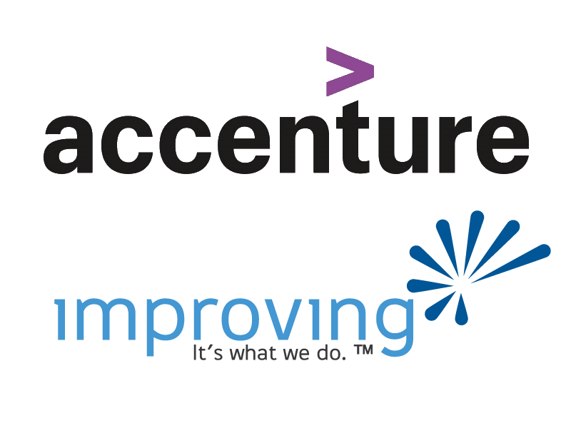

Slide 3
Azure Cosmos DB
Overview
Notes:
Azure CosmosDB – A Developer Database!!!

Slide 4



Azure Cosmos DB
A globally distributed, massively scalable, multi-model database service
Azure’s Fully Managed NoSQL Database as a service
SQL
MongoDB
Table API
Column-family
Document
Key-value
Graph
Guaranteed low latency at the 99th percentile
Elastic scale out
of storage & throughput
Five well-defined consistency models
Turnkey global distribution
Comprehensive SLAs

Slide 5













Highly integrated
Synapse Link
Power BI
Azure Functions
Azure Monitor
Private Endpoint
Cosmos DB
Logic Apps
Azure AD
Power Automate
Azure Data Factory
Azure Search
Notes:
Natively integrates with many other Azure Services for seamless interoperability
Logic App (Read, Write, Query)
Function (Trigger, Read, Write)
Search ( index)
Azure Monitor (log analytics)
Azure AD (identity + access)
PowerBI (dataset)
Synapse (export)
Vnet + Private Endpoints
Add Kafka and Spark connectors
https://learn.microsoft.com/en-us/azure/cosmos-db/nosql/sdk-java-spark-v3

Slide 6
Development
SDK, Emulator, REST API

Slide 7





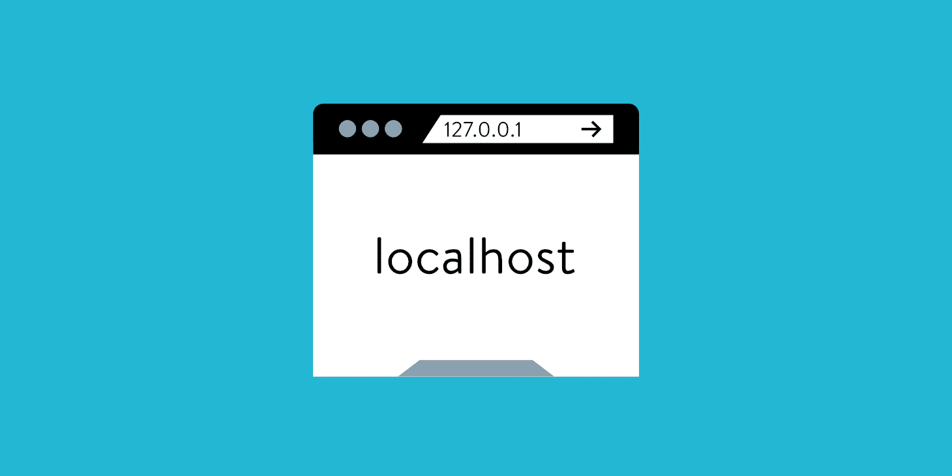
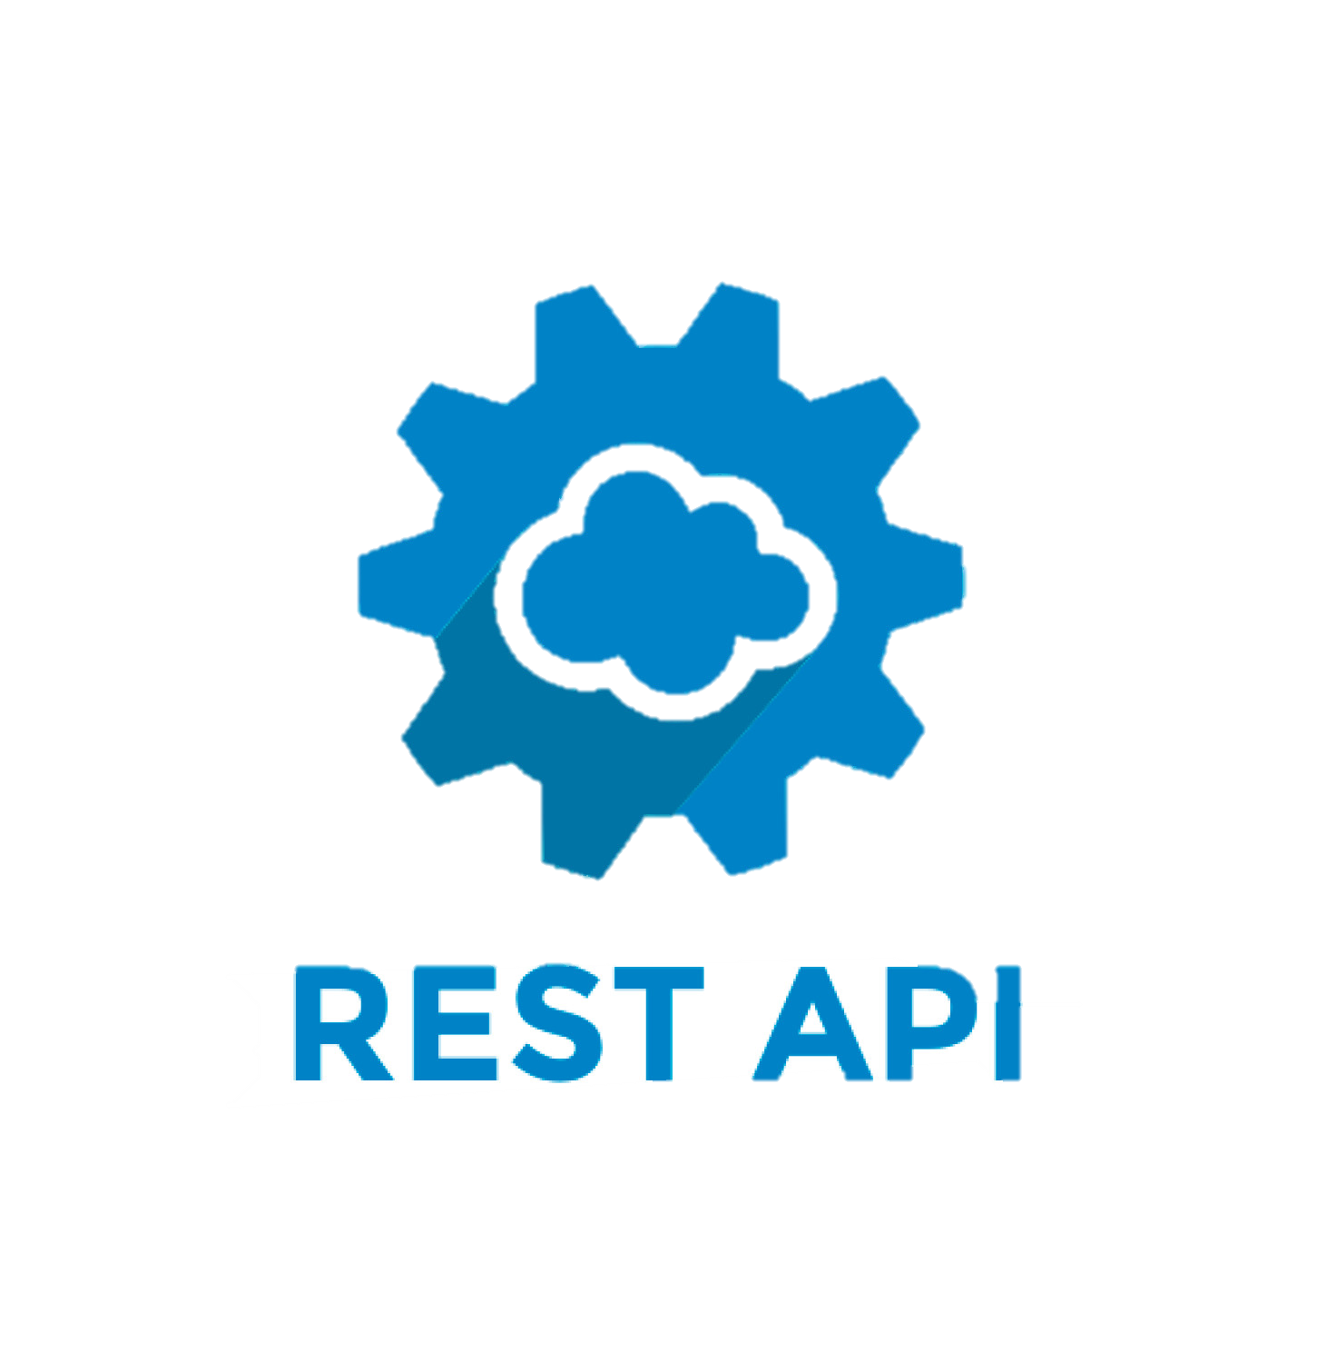




Developer friendly
Data plane
Control plane
Cosmos DB
ARM
Bicep
Az CLI
PowerShell
Notes:
SDK available in many languages (dotnet, node, java, python, go)
Lots of features and functionality built in (async, retries, provisioning, serialization etc)
REST API available
Generic
Fully integrated with Azure tooling (Arm, bicep, cli, powershell) (other too, terraform, pulumi)
Emulator for local development

Slide 8



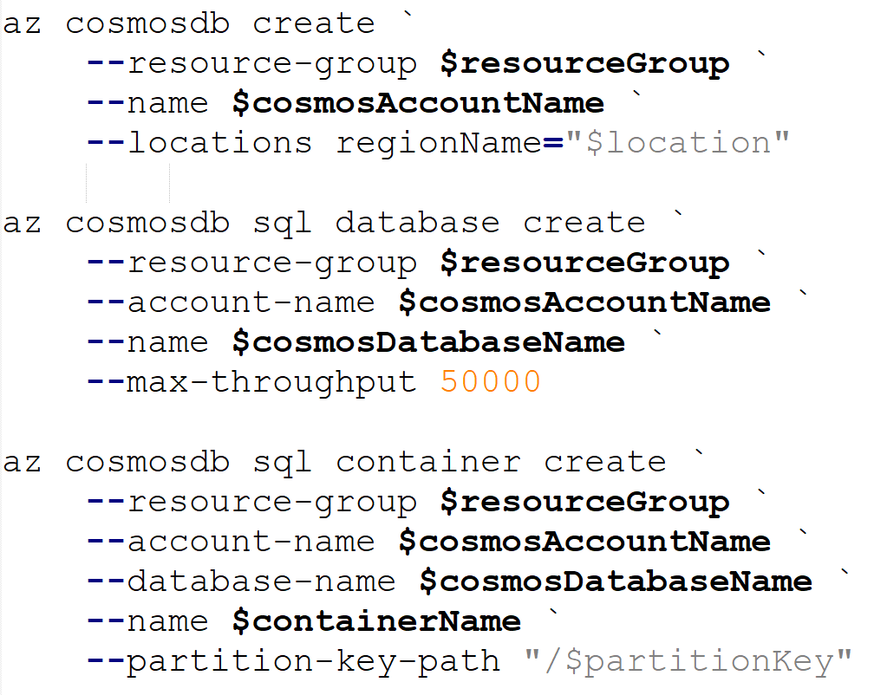
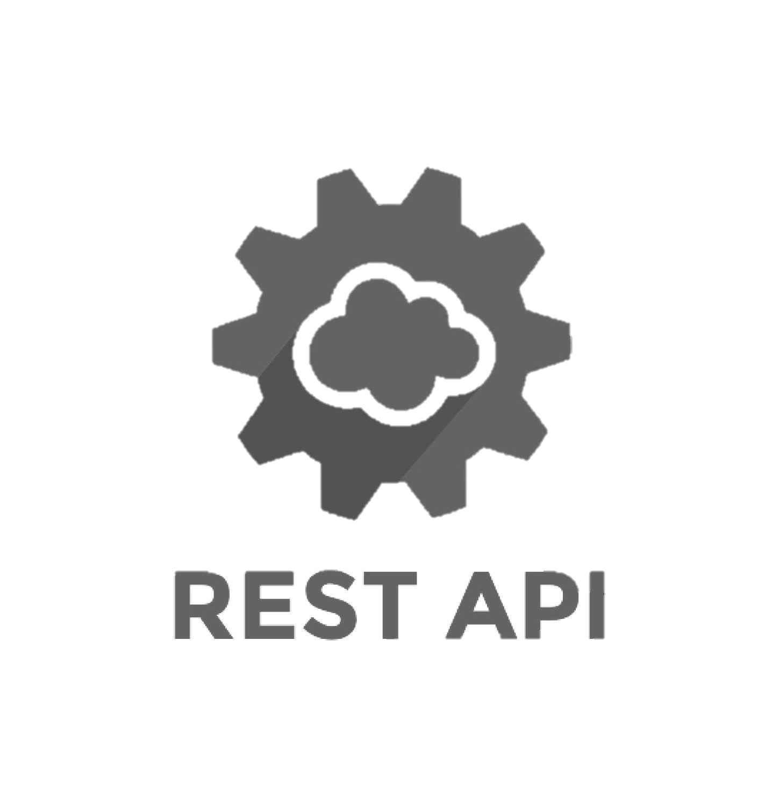
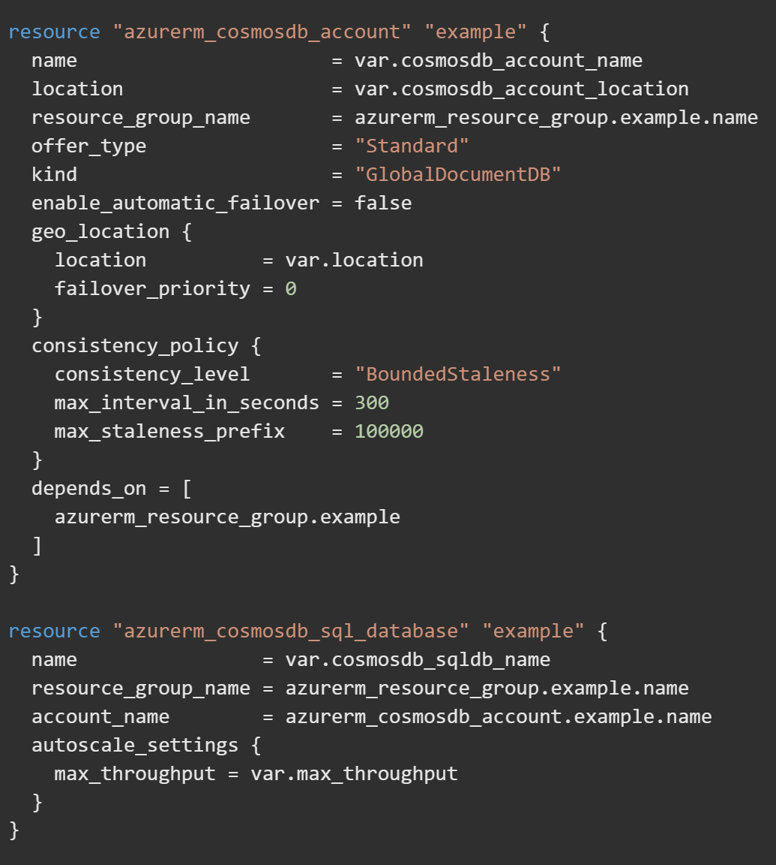




Getting started with Cosmos DB
Demo – create account
Notes:
First we will create a new Cosmos DB resource.
https://learn.microsoft.com/en-us/azure/cosmos-db/how-to-manage-database-account

Slide 9
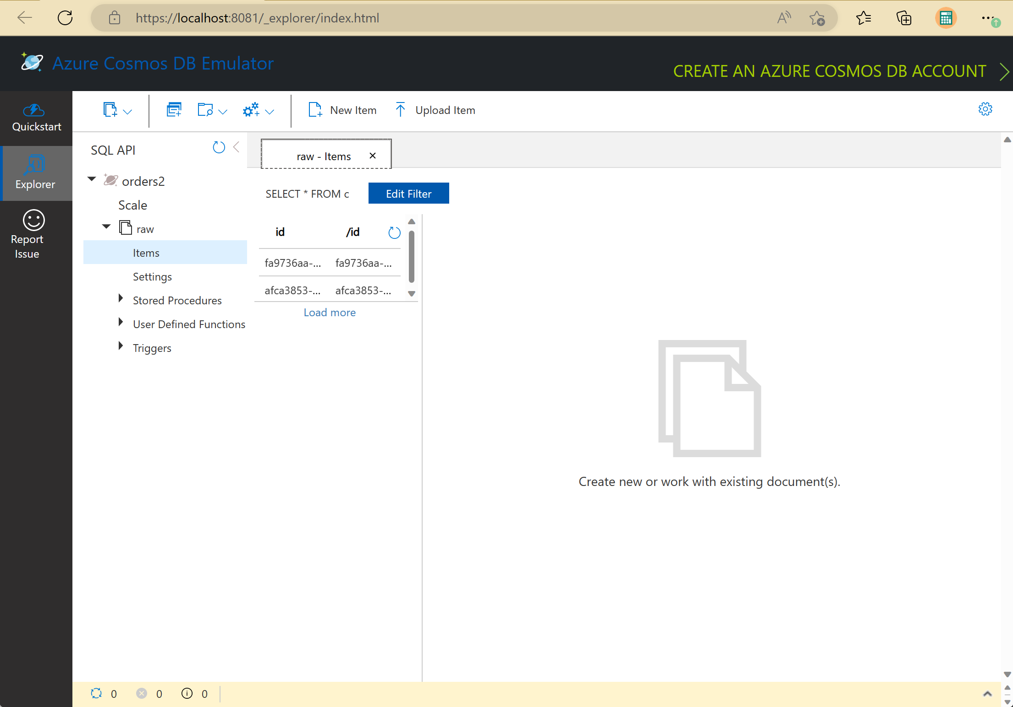


Emulator
Available as an install on Windows (All APIs)
Available as a Docker Container (SQL, Mongo)
Can be used in automated testing
Demo – start emulator
Notes:
Emulator for local development .
- Install locally either as a standalone app or via docker
- Open the emulator with: “Cosmos DB Emulator”
- Emulator is available as a webpage at: https://localhost:8081/_explorer/index.html (on windows, use the tray bar icon – Show Data Explorer)
- Create database / containers in the data explorer.
- Connection string is safe to store in the source code because it’s pointing to your local environment. Fun Fact: it’s always the same primary key.
https://learn.microsoft.com/en-us/azure/cosmos-db/local-emulator?tabs=ssl-netstd21

Slide 10
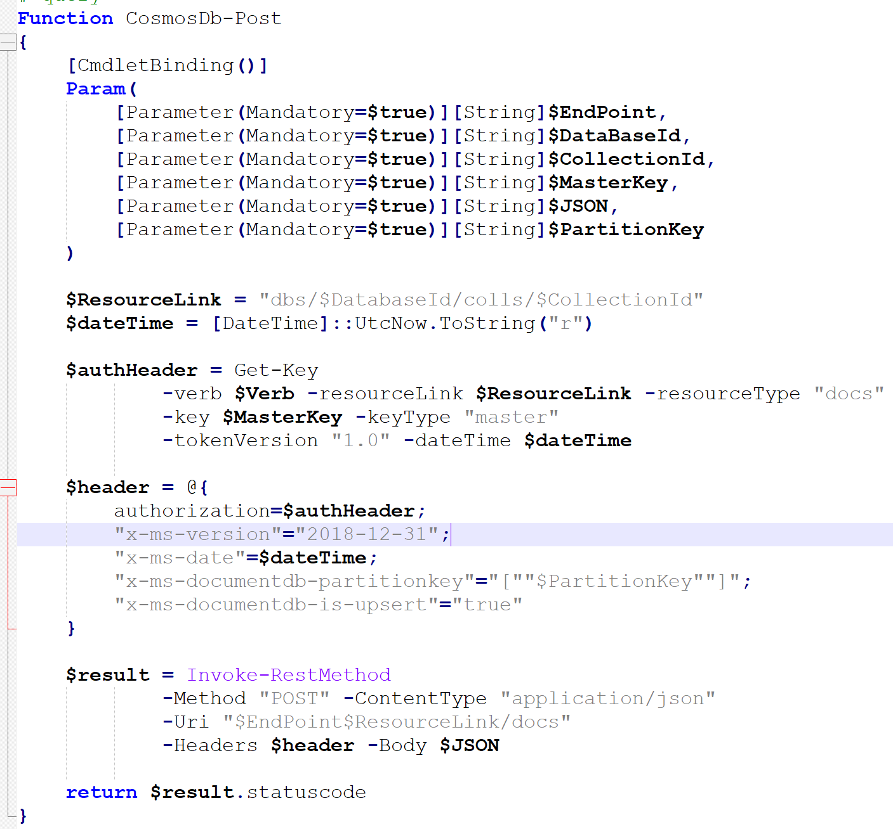

REST API
Use when no SDK available
Use in scripting environment (IaC)
Finicky but well documented
Notes:
Very useful in IaC scenarios.
Allows you to be create data in your collection while deploying an environment
https://learn.microsoft.com/en-us/rest/api/cosmos-db/

Slide 11

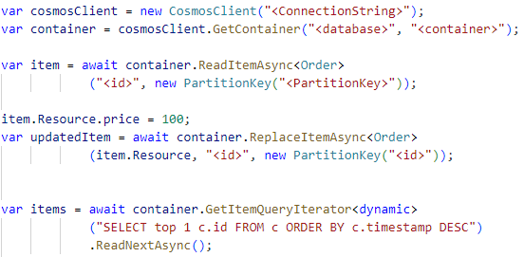
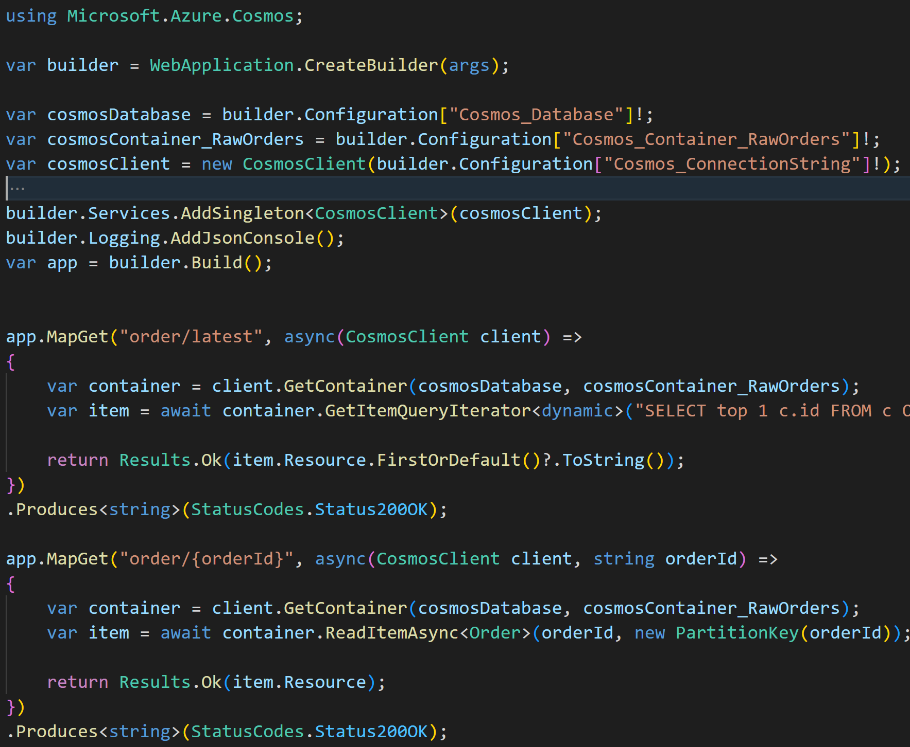
Getting started with an SDK
Easy to get started
Available in many languages
Offer advanced features
Notes:
SDK available in many languages (dotnet, node, java, python, go)
- Lots of features and functionality built in (async, retries, provisioning, serialization etc)

Slide 12
Integrations
The fun stuff…

Slide 13

Setting the stage
We are “Lukewarm Coffee”, a small coffee shop with 6 locations across Canada,
We just invested in a state-of-the-art POS system that can push orders in real-time to a pub-sub of our choice.
We want to build a system that can collect all these orders, for further analysis record keeping, and other purposes.
We’re on a mission to take on Starbucks, and we aim to have thousands of locations worldwide in the future, so it’s important that we make this as extensible as possible.

Slide 14
Scenario 1: Basics
Monitoring
Ingesting orders
Security

Slide 15










Azure Monitor
Synapse Link
Power BI
Azure Functions
Azure Monitor
All operational logs can be forwarded to Monitor
Deep integration with Kusto (built in queries)
Recommended for diagnosing as well as monitoring (Partition layouts)
Cosmos DB
Private Endpoint
Logic Apps
Azure AD
Power Automate
Azure Data Factory
Azure Search
Demo – Monitors

Slide 16
Azure Functions
Synapse Link
Power BI
Azure Functions
Azure Monitor
Azure Functions have bindings for input/output and trigger
Simple way to get data in Cosmos at scale
Supports all features of the SDK
Cosmos DB
Private Endpoint
Logic Apps
Azure AD
Power Automate
Azure Data Factory
Azure Search
Demo
– functions integration
– ingestion at scale
Notes:
- There are tons of options to configure the bindings (won’t get into all the details)
- Make sure you use the latest Functions Binding Bundle (4.x)
Removes the need to write the (little boilerplate) code you had to write
Take advantage of functions’ elasticity.
Demo Time
Replicate our “API” in a Function.
https://learn.microsoft.com/en-us/azure/azure-functions/functions-bindings-cosmosdb-v2-input

Slide 17
Azure AD
Synapse Link
Power BI
Azure Functions
Azure Monitor
More secure way than sharing the Account Key
Works with any accounts
Supported in newer SDKs
Permissions need to be assigned in CLI and not Portal
Cosmos DB
Private Endpoint
Logic Apps
Azure AD
Power Automate
Azure Data Factory
Azure Search
Demo – AD
Notes:
https://aka.ms/cosmos-native-rbac

Slide 18
Scenario 2: Extensibility
We need to provide support for a mobile app / web page where customers can see their past orders.
Our developers know that Data Modeling is very important for the performance of Cosmos DB and know that partitioning by `OrderId` will make it next to impossible to find all orders that a given customer has placed in the past…

Slide 19
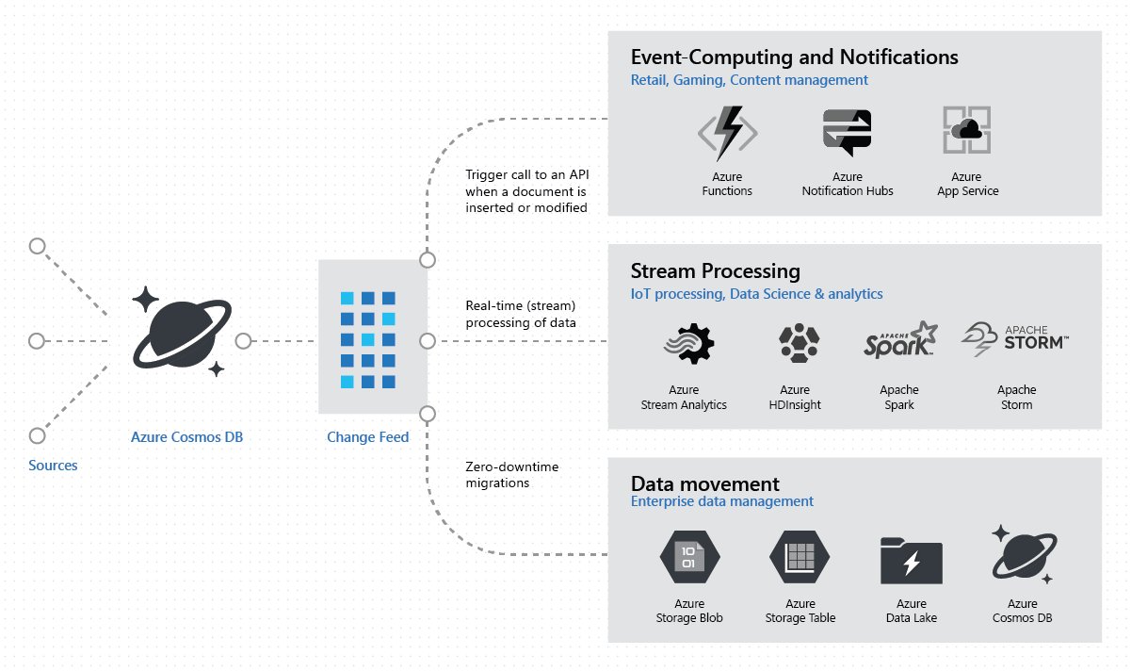
Change Feed
a persistent record of changes to a container in the order they occur.
Demo – change feed
Notes:
Working with the change feed support in Azure Cosmos DB | Microsoft Docs
Change feed in Azure Cosmos DB is a persistent record of changes to a container in the order they occur. Change feed support in Azure Cosmos DB works by listening to an Azure Cosmos container for any changes. It then outputs the sorted list of documents that were changed in the order in which they were modified. The persisted changes can be processed asynchronously and incrementally, and the output can be distributed across one or more consumers for parallel processing.
Why would we need it? Many use cases, from replay transactions if need be, to keep multiple containers in sync.
Cosmos is as good as as fast as it’s data model and partition decisions. But you might not have a good partition key for all use cases.
Let’s take our example. For our fast writes, we dump all orders with an id partition key. That is useful for quick writing, but not as useful if I want to see all orders by a customer, or by a location.
(Sure, customerId could potentially be a good primary partition key even for fast writes, but you still need locations), or even by product.
Change Feed can be used to create a cloned container, off the hot path of inserts, that copies the data in another container with a different partition key, Storage is cheap so no concerns with data dup, since it’s rather immutable data so once written we don’t need to sync it ever again.
DEMO

Slide 20
Scenario 3: Handling Reviews
The word spread that we are using Cosmos DB as our data store for all orders.
Someone in the Marketing department is wondering if we could help them track all the reviews people are leaving in our Office Form
They are just collecting results in an Excel file, but that makes it hard to run any kind of meaningful queries or analytics

Slide 21
Azure Data Factory
Synapse Link
Power BI
Azure Functions
Azure Monitor
Data Flows (SSIS on Cloud)
Optimized for bulk loads
Cosmos DB
Private Endpoint
Logic Apps
Azure AD
Power Automate
Azure Data Factory
Azure Search
Demo – bulk load

Slide 22

Azure Search
Synapse Link
Power BI
Azure Functions
Azure Monitor
Needed for Full indexed search
Incredibly easy to set up (no code required)
Cosmos DB
Private Endpoint
Logic Apps
Azure AD
Power Automate
Azure Data Factory
Azure Search
Demo – Get searching

Slide 23
Power Automate
Synapse Link
Power BI
Azure Functions
Azure Monitor
Connectors to interact with Cosmos
Enables Low-Code / No-Code flows
Cosmos DB
Private Endpoint
Logic Apps
Azure AD
Power Automate
Azure Data Factory
Azure Search
Demo – Add Reviews

Slide 24
Scenario 4: Analytics
We have nearly a million orders logged, easily handled by our Cosmos database
But our business is starting to ask us some good questions:
What’s my most popular menu-item, in each location?
What’s the most popular location?
What are the popular times when customers come to our shop?
Etc…
Our analytics team implemented some APIs on top of our database, but they were slow, and they were afraid their long running queries will impact the order flow.

Slide 25
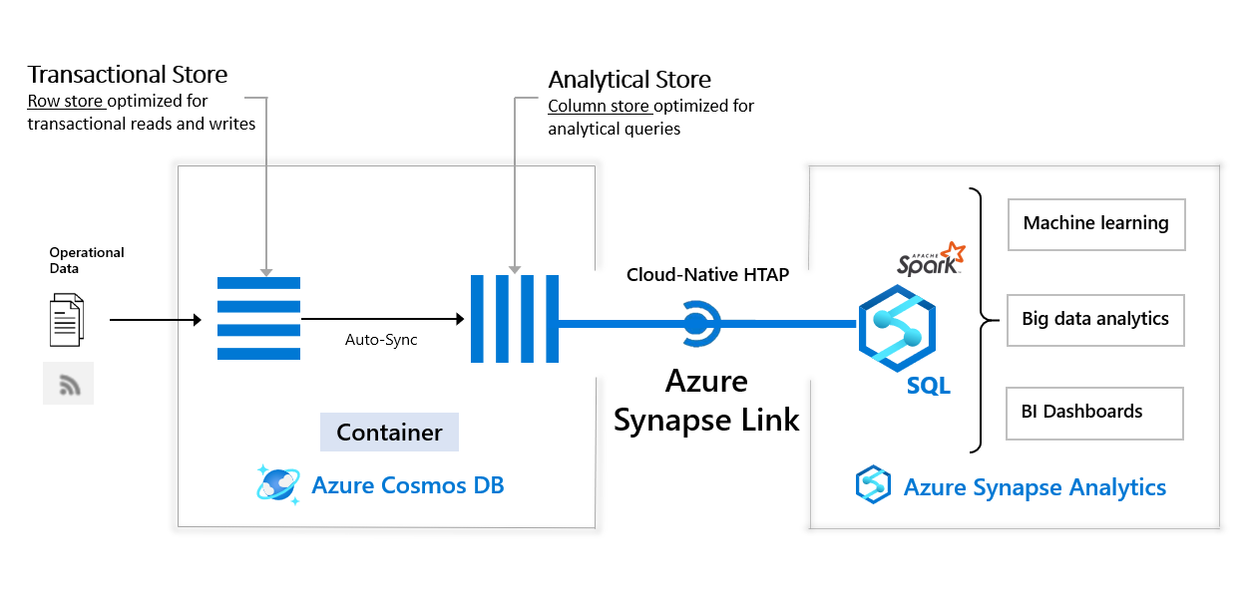
Synapse Link
Synapse Link
Power BI
Azure Functions
Azure Monitor
Hybrid Transactional and Analytical Processing (HTAP) capability
Enables to run near real-time analytics over operational data
Cosmos DB
Private Endpoint
Logic Apps
Azure AD
Power Automate
Azure Data Factory
Azure Search
Notes:
Azure Synapse Link for Azure Cosmos DB, benefits, and when to use it | Microsoft Docs
Azure Synapse Link for Azure Cosmos DB is a cloud native hybrid transactional and analytical processing (HTAP) capability that enables you to run near real-time analytics over operational data. Synapse Link creates a tight seamless integration between Azure Cosmos DB and Azure Synapse Analytics.

Slide 26
Summary
Enabled monitoring
Secured with Azure AD
Used Azure Functions to read/write/transform data
Bulk load reviews
Created a review submission form
Enable review searching
Enabled analytics and reporting
Synapse Link
Power BI
Azure Functions
Azure Monitor
Private Endpoint
Logic Apps
Cosmos DB
Azure AD
Power Automate
Azure Data Factory
Azure Search

Slide 27

Thank you!
@alexdrenea

